Slide 1
CLOUD PIPE LINE ENGINEERING-AMAZON WEB SERVICE
Objective: The objective of this project is to design and implement a scalable end-to-end data engineering pipeline that extracts raw data from a GitHub repository, processes and transforms it using a Python ETL script, stores structured data in PostgreSQL (Amazon RDS) and unstructured data in MongoDB Atlas, archives raw data in Amazon S3 as a data lake, and delivers meaningful insights through an interactive Streamlit dashboard..
by
P Shesha Shayana Reddy, Venu kamatam and Dinesh Karthik

Slide 2
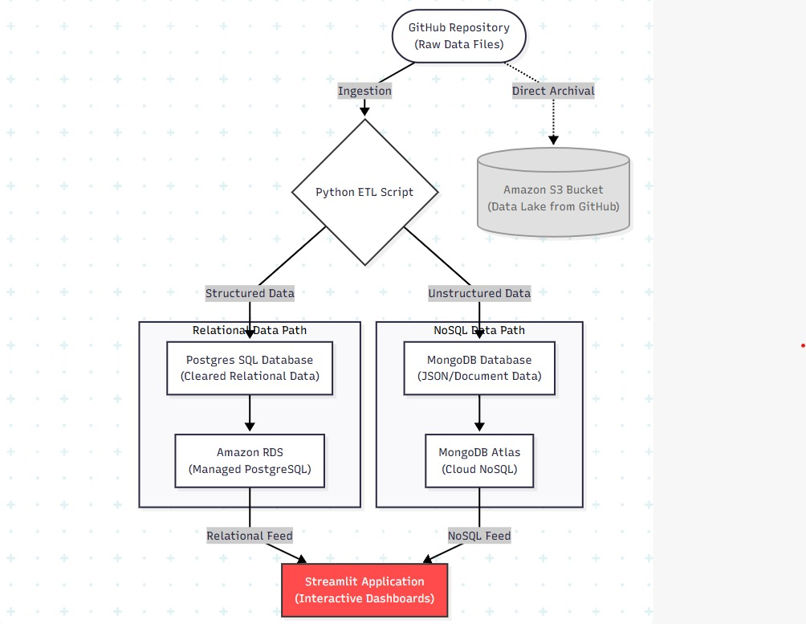

Slide 3
Data Sourcing & Archival Strategy
  The Source: Raw JSON metadata and transcript files ingested from a GitHub Repository.
  The Data Lake: Direct archival of raw files into an Amazon S3 Bucket for long-term storage and recovery.
  The Challenge: Handling massive volumes of text-heavy files with inconsistent naming formats.

Slide 4
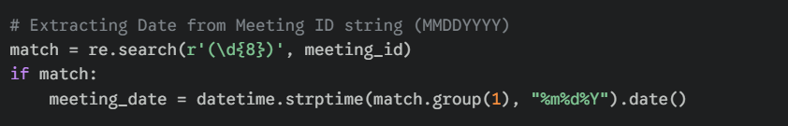
Text Cleaning & Regex
  Parsing Logic: Using Regular Expressions to extract 8-digit date codes and city identifiers from messy meeting IDs.
  Data Validation: Implementing os.walk to physically verify that transcript files exist before processing.
  Code Snippet:

Slide 5
Feature Engineering
  Quantifying Meetings: Generating numerical insights such as speaker_count and word_count from raw JSON.
  Uniqueness: Using Python set() objects to identify unique participants across diverse segments.
  Verbal Load: Deep-nested iteration through nbest word lists to calculate the total verbal length of sessions.

Slide 6
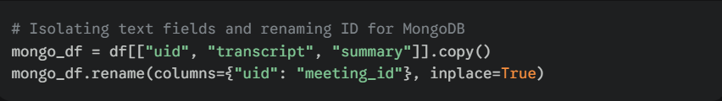
Data Bifurcation
  Relational Output: Flattening metadata into a tabular CSV for PostgreSQL.
  Unstructured Output: Isolating heavy text fields (transcripts/summarises) for the MongoDB document store.
  Code Snippet:

Slide 7
Managed Relational Storage (Amazon RDS)
  Technology: PostgreSQL hosted on Amazon RDS (eu-north-1).
  Purpose: Handling structured metrics like city, date, and speaker counts for rapid analytical querying.
  Architecture Link: As shown in the diagram, this serves as the "Relational Feed" for our application.

Slide 8
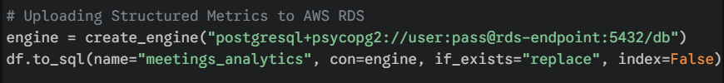
Automated SQL Ingestion Pipeline
  Local Storage: CSV data is first structured and stored in a local PostgreSQL database
  Database Migration: The cleaned and transformed PostgreSQL table is then uploaded to Amazon RDS (PostgreSQL) in the AWS cloud.
  Data Transfer: Python (psycopg2 / database connector) is used to establish a secure connection and transfer structured data to AWS RDS
  Code Snippet:

Slide 9
Document-Store Strategy (MongoDB Atlas)
  Technology: MongoDB Atlas.
  Data Process: Python transforms processed CSV data into JSON-like BSON records for cloud ingestion.
  Schema Design: Each meeting is stored as a document containing meeting_id, transcript, and summary.
  Core Advantage: Flexible schema handles variable-length transcripts without the rigid constraints or "table bloat" of SQL

Slide 10
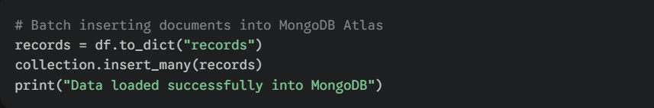
Scalable NoSQL Data Workflow
  Transformation: Converting tabular DataFrames into a list of dictionaries for bulk ingestion.
  Latency Management: Using insert_many to minimize API calls during the upload of thousands of transcripts.
  Code Snippet:

Slide 11
Streamlit UI Development
  Philosophy: A unified dashboard that converges data from two different database types into one interface.
  Connectivity: Real-time fetching from PostgreSQL (Relational Feed) and MongoDB (NoSQL Feed).
  Visual: Page configured in wide mode to allow for side-by-side data exploration.

Slide 12
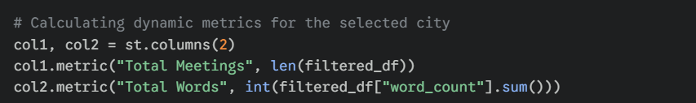
Dynamic Business Intelligence (BI)
  Interactivity: Sidebar filters for "City" dynamically re-query the SQL database.
  Visualizations: Using Seaborn and Matplotlib to render word count trends over time and speaker distributions.
  Code Snippet:

Slide 13
Cross-Database Integration
  The Join Logic: Using the shared meeting_id to link the SQL-driven meeting list to the NoSQL-driven transcript viewer.
  Efficiency: Full transcripts are only loaded into memory when a specific meeting is selected by the user.
  Logic Snippet: transcript_row = transcripts_df[transcripts_df["meeting_id"] == selected_meeting].

Slide 14
Project Summary & Roadmap
  Achievements: Built a scalable, bifurcated pipeline that optimizes storage based on data type.
  Future Scope: * LLM Integration: Adding a chatbot to answer questions about specific transcripts in the MongoDB store.
  Sentiment Analysis: Calculating meeting tone using NLP directly on the ingested text.
  Visual:

Slide 15
THANK YOU

